Slide 1
Disaster Management Mobile Application
Requirements Gathering Phase
Group 7

Slide 2
Table of contents
01
02
04
05
03
06
07
Objectives
Stakeholders
Questionnaires
Research
Brainstorming
Interviews
Conclusion

Slide 3
01
Objectives
Purpose of carrying out requirement gathering

Slide 4
2. Understand User Needs
Identify our target audience
3. Clarify Stakeholder Expectations

Slide 5
02
Stakeholders
Who are those involved as far as the Disaster Management App is concerned

Slide 6



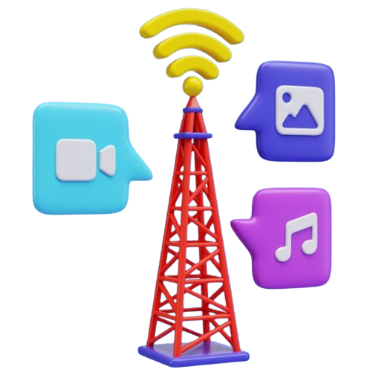

Emergency Responders
Community Members of Localities
Technology Providers
NGO and Humanitarian Organizations
Broadcast stations

Slide 7
03
Brainstorming
Spontaneous contribution of creative ideas and solutions.

Slide 8
Category of Questions and Ideas
User Needs and Expectations
This category focused on understanding the specific requirements, preferences, and challenges of potential users
Scenario-based Questions
These questions aimed to gather insights into users' real-life experiences related to disasters.
Location-based Ideas
These questions involve gathering information about users' geographical locations.

Slide 9
User Needs and Expectations
Questions Asked
How do we empathize with the stakeholders of the application?
Will users adopt this application and why?

Slide 10
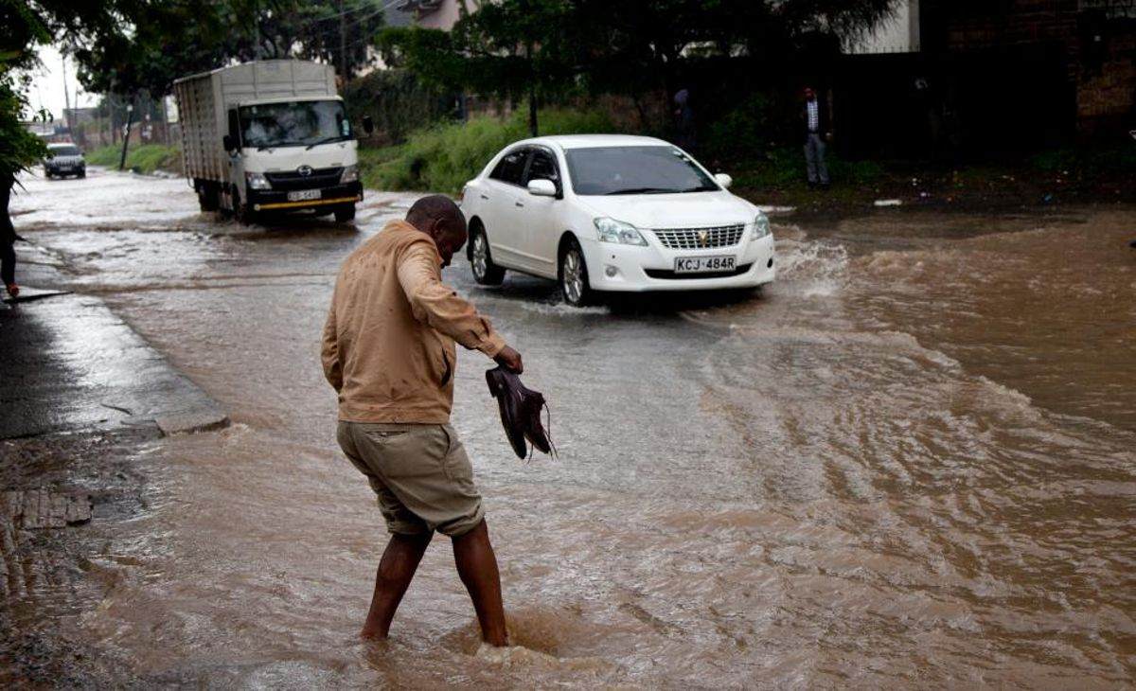
Ideal User Persona
Name: Hakuna Matata
Age: 25
Occupation: Small Business Owner
Location: Buea, Southwest Region, Cameroon
Background: Matata, a small business owner in Buea, Cameroon, has witnessed the devastating impact of seasonal flash floods on his community. Despite facing challenges such as property damage and income loss, Matata remains committed to rebuilding and enhancing resilience in Buea.

Slide 11
Matata wants to…
Be Prepared
Stay Informed
He aims to develop a disaster preparedness plan for his business and family.
He expects to receive timely and accurate updates and alerts about potential flood risks.
Connect with others
Access Resources
He hopes to connect with his neighbors, community leaders, and emergency responders.
He needs access to a wide range of resources and services, including maps, emergency contacts, financial assistance programs.

Slide 12
Scenario-based Questions
Questions Asked during session
What would we do in case a disaster occured now?
What can we do to help without the application?

Slide 13
In case of disaster occurrence…
Take Immediate Action
Look for a safe place
Protect friends and family.
Get more information
Know where it is taking place (radio, TV or social media)
Seek shelter locations or escape routes.
Help Others
If safe, assist others who need help.
Provide first aid and medical assistance

Slide 14
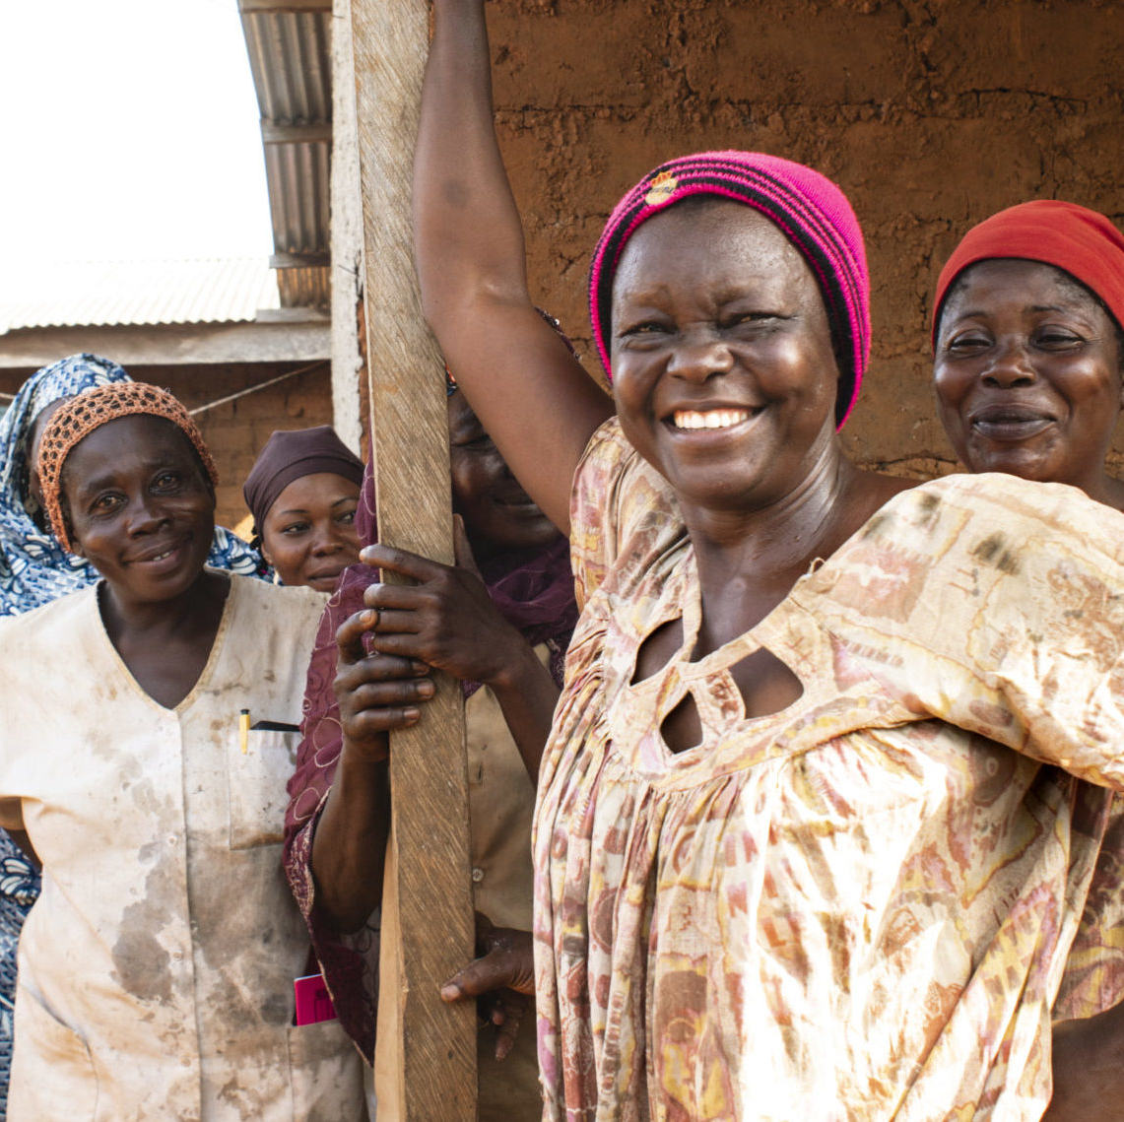
Location-based Ideas
With respect to our location Cameroon, we developed ideas such as:
Use USSD technology and messages to communicate will those who do not use smartphones.
Keep community members rather prepared in case of a disaster occurrence.
Communicate in the local and most understandable language, pidgin.

Slide 15
04
Questionnaires
Collected data from individuals and stakeholders on

Slide 16
Google Form Intro
This questionnaire is designed to gather information about your experiences, requirements, and expectations regarding a mobile app for disaster management. Your responses will be kept confidential and used solely for research purposes.
Please take a few moments to complete the questionnaire. Your feedback is greatly appreciated!

Slide 17
Some Questions Asked
Age range
Have you ever experienced a natural disaster or emergency situation? If yes, please briefly describe your experience.
How often do you seek information or prepare for potential disasters or emergencies?
How do you currently stay informed about potential disasters or emergencies in your area?
Do you have an emergency preparedness plan in place? If yes, please describe briefly.
What challenges do you face in preparing for and responding to disasters or emergencies?
What features would you like to see in a mobile-based disaster management app?

Slide 18
Notable Responses
Respondent: njinjuk@gmail.com (experienced a disaster)
19-30
“Yes it was an overflow of water from the mountain. It was strong it broke down walls and entered houses”
Occasionally
Social media
No emergency plan
“Built fences to divert the water”
Real-time alerts, location-based services, emergency contacts directory.

Slide 19
Notable Responses
Respondent: jamilaidoko1@gmail.com (no experience)
19-30
“No”
Rarely
The Internet
No emergency plan
“Challenge of a good sheltered place to stay during disasters and no real-time alerts during such”
Real-time alerts, location-based services, communication tools, emergency contacts directory, offline functionality, multi-language support, ...

Slide 20
05
Research
Recent cases of disasters that happened, causes, consequences and actions taken

Slide 21
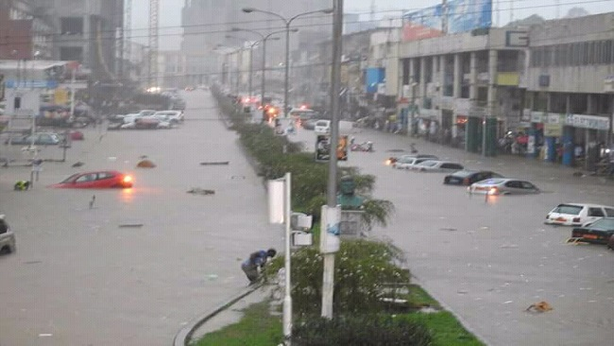
Disaster description: Flood
Continuous heavy rain falls, resulting in flooding and landslides
Cause:
Run-off water, unplanned construction, preventing water from circulating
Zones affected and numbers
Church Street (700)
Mawoh (400)
Down beach (500)
Total: 1600 people affected
Other collateral damages
Destruction of goods in shops,
Destruction of buildings etc
Date: 18-19 July 2023
Location: South-West, Limbe

Slide 22
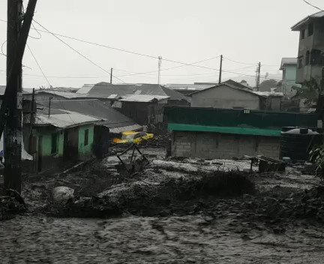
Disaster description: Flood
Torrential rains in Buea leading to intensive flash floods and mudslides
Origin:
Surging from Mt Cameroon
Preliminary studies
2 deads, 4 hospitalized and one reported missing.
Estimated 3000 people affected
Other collateral damages
Households lost their livelihood, livestock, crops etc
Destruction of water catchment in Buea and water supply pipes
Date: 18 March 2023
Location: South-West, Buea

Slide 23
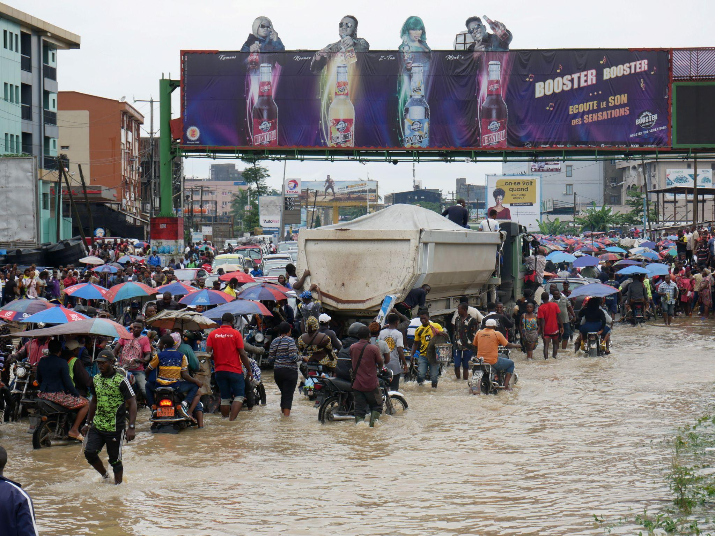
Disaster description: Flood
Flood in the densely populated Makepe, neighborhood in Douala
Cause:
Massive increase in population
Poor planning and Infrastructural investment
Physical geography setting, conducive for inducement of floods
Consequences
Nearly 2210 buildings and 12376 victims spread over 82 hectares
What was done?
Developing a model, classifying flood risks
Simulations providing detailed information on flood characteristics like velocity, depth, arrival time, duration etc
Date: Aug, 21st 2020
Location: Douala, Makepe Missoke

Slide 24
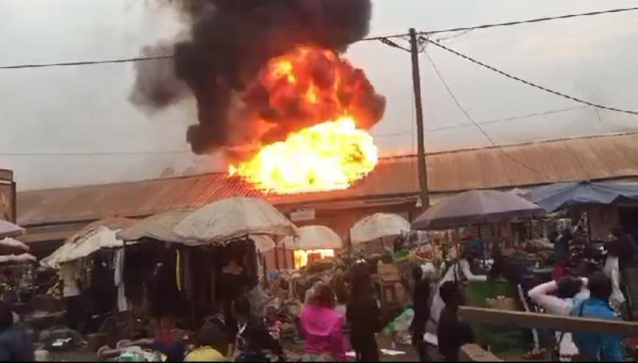
Disaster description: Fire
Fire incident in Bamenda main market, largest in North West
Cost:
In assessing the damage, authorities estimated in billions of CFA francs
Consequences
Close to 300 shops destroyed by the fire (provisional figure)
Actions taken?
Elites and public government figures launched a fundraising campaign, totalling a sum of 43 millions FCFA collected.
Date: Feb 2024
Location: Bamenda, North West

Slide 25
06
Interviews
Onsite discussions made with stakeholders such as disaster survivors, researchers, and individuals who haven't experienced disasters.

Slide 26
Interviews were conducted with the following groups:
Disaster Survivors
Individuals who have experienced natural or man-made disasters firsthand, offering unique perspectives on challenges faced and requirements for effective disaster management.
Researchers
Experts in disaster management and related fields, providing insights based on scholarly research, best practices, and theoretical frameworks.
Individuals without Disaster Experience
Representing the general population, these individuals offer perspectives on preparedness, awareness, and the potential impact of a disaster on their lives.

Slide 27
Key Questions Asked to…
1. Disaster Survivors
- Can you describe your experience during the disaster event?
- What were the most significant challenges you faced in terms of communication, access to resources, and coordination?
- How did you receive information and alerts about the disaster?
- What functionalities do you think would have been helpful in managing the situation more effectively?
Name: Daniel Carlson
Profession: Software Engineer
Location: Buea Town
Disaster Experienced: Earthquake

Slide 28
Key Questions Asked to…
2. Researchers
- Based on your expertise, what are the key factors contributing to effective disaster management?
- What emerging technologies or methodologies show promise in improving disaster response and recovery efforts?
- From your research, what are the common challenges faced by stakeholders involved in disaster management?
- Are there any specific requirements or best practices that should be considered in the design of a disaster management system?
Name: Dr Mafany Teke
Profession: Geologist (Regional Delegate of Scientific Research and Innovation)
Location: Buea
Disaster Experienced: Earthquakes, Floods, to name a few

Slide 29
Key Questions Asked to…
3. Individuals Without Disaster Experience
- How would you rate your level of preparedness for a potential disaster?
- What sources do you rely on for information and updates during emergency situations?
- What features or functionalities would you expect from a disaster management system to help you better prepare for and respond to disasters?
- In your opinion, what role should technology play in improving disaster preparedness and response efforts?
Name: Hapsatu Nasiru
Profession: Student
Location: Buea

Slide 30
07
Conclusion
Final say for requirement gathering

Slide 31
All data fell under the following:
01
02
03
04
Preparedness
Response
Recovery
Mitigation

